Slide 1

DIABETIC RETINOPATHY DETECTION
NAME –SNEH SHAH
ROLL NO-30
COURSE –DATA SCIENCE
SCHOOL OF EMERGING SCIENCE AND TECHNOLOGY

Slide 2
OUTLINE
Abstract
Introduction
Objective
Project Workflow
Methodology
Results
Conclusion
References

Slide 3
ABSTRACT
Diabetic retinopathy is a complication caused by diabetes that affect the human eye. It is caused by the mutilations of the blood vessels of the light sensitive tissues at the back of the human retina. It’s the most recurrent form of blindness in the working age group of people and is highly likely when diabetes is poorly controlled . Although method for detection of Diabetic retinopathy exist, they involve manual examination of the retinal image by an ophthalmologist. The proposal approach of diabetic retinopathy detection aims to detect the complication using machine learning and deep learning

Slide 4
INTRODUCTION
Diabetic Retinopathy (DR) is human eye disease among people with diabetics which causes damage to retina of eye and may eventually lead to complete blindness. The blood vessel in the retina will swell up which result in its rupture which in turn leads to blindness . The initial stage of DR are categorized just by swelling and the final stage by rupturing of blood vessels. The Detection of diabetic retinopathy in early stage is essential to avoid complete blindness. Effective treatments for DR are available though it requires early diagnosis and the continuous monitoring of diabetic patients. Also, many physical tests like visual acuity test, pupil dilation, and optical coherence tomography can be used to detect diabetic retinopathy but are time consuming. It involves dilating the eye to widen the pupil, performing fluorescein angiography ,using a special camera to capture an image of the retina and then examination by the clinician. It is one of the most common diabetic eye diseases and a leading cause of blindness. Nearly 415 million diabetic patients are at risk of having blindness because of diabetics.

Slide 5
OBJECTIVE
The objective of this project is to give decision about the presence of diabetic retinopathy by applying different machine learning algorithms and using deep learning algorithms on images to extract features from different retinal image. It will give us accuracy of which algorithm will be suitable and more accurate for prediction of the disease.

Slide 6
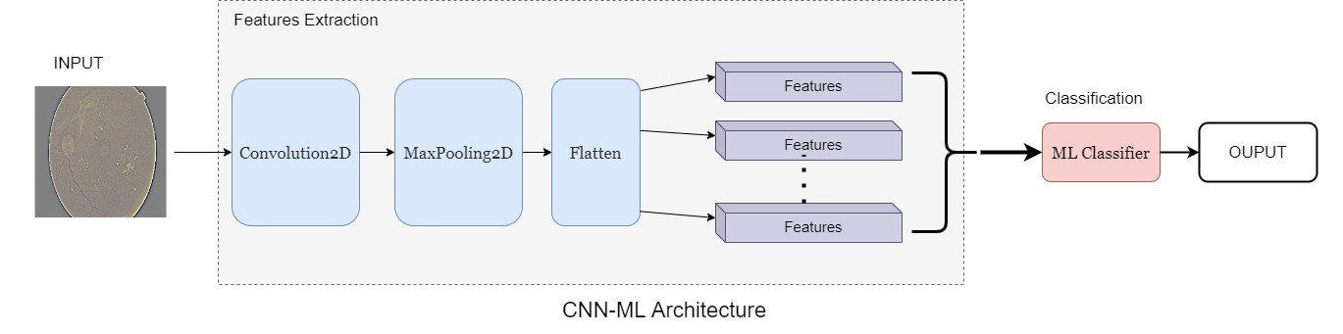
PROJECT WORKFLOW
Data Collection
Data Preprocessing
Feature Engineering
Data Modelling

Slide 7
DATA COLLECTION
I have collected the data from Kaggle. The original dataset is available at APTOS 2019 Blindness Detection in Kaggle competition I have directly collected the preprocessed data of the original dataset
The dataset consist of 3362 retina scan images.
The images consist of gaussian filtered retina scan images to detect diabetic retinopathy.
These images are resized into 224x224 pixels so that they can be readily used with many pre-trained deep learning models.

Slide 8
DATA DESCRIPTION
The images are already saved into their respective folders according to the severity/stage of diabetic retinopathy using the train.csv file provided. Here DR is an abbreviation for diabetic retinopathy
You will find five directories with the respective images:
0 - No_DR
1 - Mild
2 - Moderate
3 - Severe
4 -Proliferate_DR

Slide 9
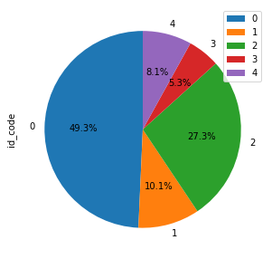
DISTRIBUTION OF DATASET
As we can see the data is very unbalanced :-
50% of the data contains no diabetic retinopathy images.
10% contains mild diabetic retinopathy images.
27%contains moderate diabetic retinopathy images.
5%contains severe diabetic retinopathy images.
8% contains proliferative diabetic retinopathy images.

Slide 10
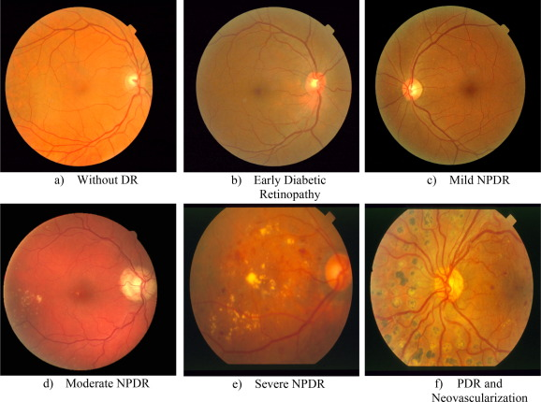
EXAMPLE IMAGE

Slide 11
FEATURE ENGINEERING
Since the data has been already pre-processed , the images will now extract features which will be used by the model to predict diabetic retinopathy
Convolution neural network(CNN) has been used to extract features of diabetic retinopathy images
CNN is a neural network that extracts input image features, and another neural network classifies the image features.
The input image is used by the feature extraction network. The extracted feature signals are utilized by the neural network for classification.

Slide 12
FEATURE ENGINEERING
The neural network classification then works based on the image features and produces the output.
The neural network for feature extraction includes convolution layer piles and sets of pooling layers. As its name implies, the convolution layer transforms the image using the process of the convolution.
The layer of pooling transforms the neighboring pixels into a single pixel.
The pooling layer then decreases the image dimension. As CNN’s primary concern is the image, the convolution and pooling layers procedures are intuitively in a two-dimensional plane.

Slide 13
DATA MODELING
I went through algorithms that provides better result as we are working on classification of diabetic retinopathy, we used some machine learning classification algorithms.
The Machine Learning system uses the training data to train models to see patterns and uses the test data to evaluate the predictive quality of the trained model.
Machine learning system evaluates predictive performance by comparing predictions on the evaluation data set with true values using a variety of metrics.

Slide 14
DATA MODELING
Evaluation of CNN (convolution neural network) and four different machine learning algorithms using the features extracted from CNN
• Support Vector Machine (SVM)
• Decision tree
• K-Nearest Neighbor (KNN)
• Random Forest

Slide 15
TRAIN AND TEST SPLIT
Train images: (2746, 150, 150, 3)
Test images: (916, 150, 150, 3)
Train label: (2746, 5)
Test label: (916, 5)
Extracted features from CNN = (2746, 1024)

Slide 16
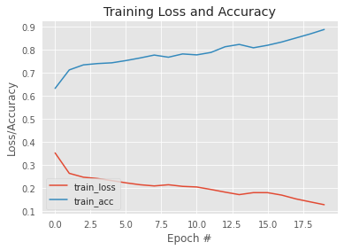
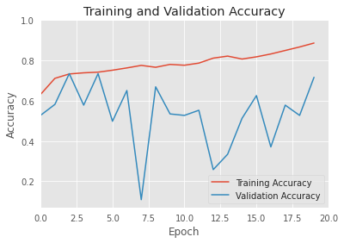
RESULT
CNN MODEL
Training Accuracy Score: 76.18353969410052
Testing Accuracy Score:-69.65065502183407
precision recall f1-score support
0 1.00 0.03 0.06 100
1 0.49 0.96 0.65 245
2 0.93 0.92 0.92 433
3 0.17 0.01 0.02 79
4 0.00 0.00 0.00 59
accuracy 0.70 916
macro avg 0.52 0.38 0.33 916
weighted avg 0.69 0.70 0.62 916

Slide 17
RESULT
SVM Training Accuracy Score:- 81.86453022578296
SVM Testing Accuracy Score:-72.81659388646288
precision recall f1-score support
0 0.44 0.29 0.35 100
1 0.56 0.86 0.68 245
2 0.91 0.98 0.94 433
3 0.00 0.00 0.00 79
4 1.00 0.03 0.07 59
accuracy 0.73 916
macro avg 0.58 0.43 0.41 916
weighted avg 0.69 0.73 0.67 916

Slide 18
RESULT
Decision Tree Training Accuracy Score:- 99.2352512745812
Decision Tree Testing Accuracy Score:- 64.8471615720524
precision recall f1-score support
0 0.42 0.40 0.41 100
1 0.56 0.60 0.57 245
2 0.90 0.89 0.90 433
3 0.19 0.19 0.19 79
4 0.12 0.10 0.11 59
accuracy 0.65 916
macro avg 0.44 0.44 0.44 916
weighted avg 0.65 0.65 0.65 916

Slide 19
RESULT
KNN Training Accuracy Score:- 83.94027676620539
KNN Testing Accuracy Score:-71.06986899563319
precision recall f1-score support
0 0.37 0.42 0.39 100
1 0.58 0.73 0.65 245
2 0.90 0.97 0.93 433
3 0.26 0.06 0.10 79
4 0.43 0.10 0.16 59
accuracy 0.71 916
macro avg 0.51 0.46 0.45 916
weighted avg 0.67 0.71 0.68 916

Slide 20
RESULT
random forest Training Accuracy Score:-98.2884195193008
random forest Testing Accuracy Score:- 70.9606986899563
precision recall f1-score support
0 0.41 0.34 0.37 100
1 0.59 0.79 0.67 245
2 0.89 0.96 0.92 433
3 0.21 0.05 0.08 79
4 0.25 0.07 0.11 59
accuracy 0.71 916
macro avg 0.47 0.44 0.43 916
weighted avg 0.65 0.71 0.67 916

Slide 21
RESULT
Training Accuracy
CNN Accuracy:- 76.18 %
CNN-SVM Accuracy:- 81.86 %
CNN-DT Accuracy:- 99.24 %
CNN-KNN Accuracy:- 83.94 %
CNN-RF Accuracy:- 98.29 %
Testing Accuracy
CNN Accuracy:- 69.65 %
CNN-SVM Accuracy:- 72.82 %
CNN-DT Accuracy:- 64.85 %
CNN-KNN Accuracy:- 71.07 %
CNN-RF Accuracy:- 70.96 %

Slide 22
CONCLUSION
We have tried to construct an ensemble to predict if a patient has diabetic retinopathy using features from retinal photos. After training and testing the SVM with CNN features is providing higher accuracy rate for predicting DR followed by KNN with CNN features. As the dataset of images was unbalanced, we can see that there was overfitting of models . To improve the model accuracy and reduce the overfitting we will have to balance the data where all types of diabetic retinopathy have equal or near to equal number of images .
I have also faced some problems while choosing algorithms. It was quite difficult for me to choose some specific machine learning algorithms that would give accurate classification of the disease. Possibility there be other parameter spaces that would yield better performing models.

Slide 23
REFERENCES
https://www.kaggle.com/datasets/sovitrath/diabetic-retinopathy-224x224-gaussian-filtered
https://www.sciencedirect.com/topics/computer-science/feature-extraction-network
https://ieeexplore.ieee.org/abstract/document/6680633
http://ictactjournals.in/paper/IJSC_V3_I4_Paper_1_563-575.pdf
Maisha Maliha ,Ahmed Tareque ,Sourav Saha Roy. “Diabetic Retinopathy Detection Using Machine Learning”. Published on 04,2018

Slide 24
THANK YOU

